Slide 1
Abelian Kingdom
Andrew, Kelvin and Peter

Slide 2
What is it?
A web (browser) game
MORPG on Google map
Login with Facebook
Interact with your friends
And the real street and store!

Slide 3

HTML
Javascript
CSS
Nginx
Thin
Thin
Thin
Database

Slide 4
MVC
Controller
Model
View

Slide 5
HTML
Google Map API
Providing
  Longitude, Latitude translation
  Route plan
  Road data

Slide 6
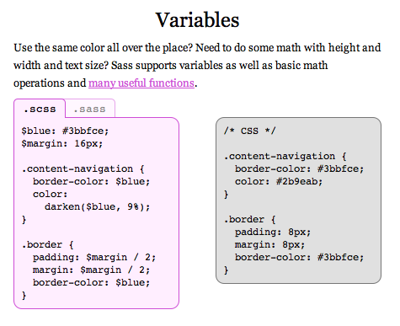
CSS
SCSS

Slide 7
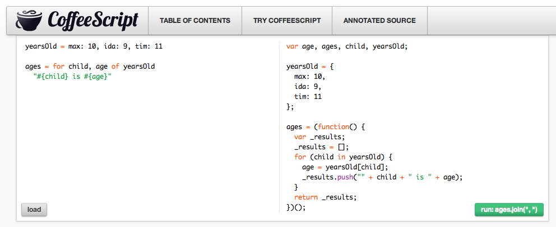
Javascript
Coffeescript

Slide 8
Javascript
jQuery
  Awesome Javascript library!
  Simplify DOM manipulation and AJAX
Backbone.js
  MVC framework on client side

Slide 9

Ruby on Rails
Web framework
MVC Structure

Slide 10
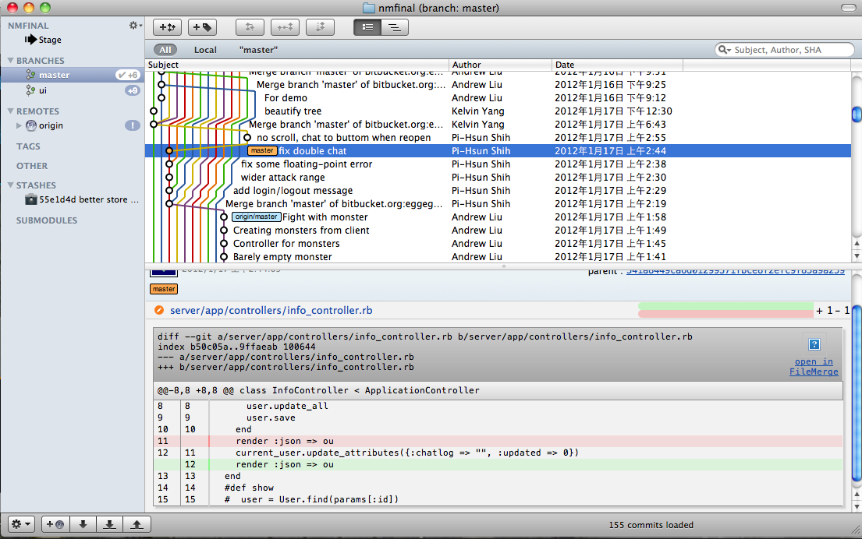

Slide 11
DEMO!

