Slide 1
FINAL PROJECT
FALLING BALL ONLINE
NMLab 2010 Spring
B94901141 翁肇澤
B96901079 溫宗憲
B96901020 吳昭遠

Slide 2
Motivation
The Classical Game “Falling ball”
Which is installed in Milton’s HERO
Let’s take a look it !

Slide 3
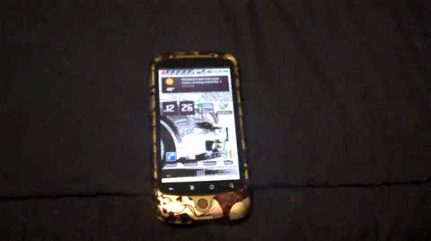
Falling Ball v.Single

Slide 4
Motivation
The Classical Game “Falling ball”
Which is installed in Milton’s HERO
Let’s take a look it !
But, What if now that Milton wants to play with his best friend, Hank?

Slide 5
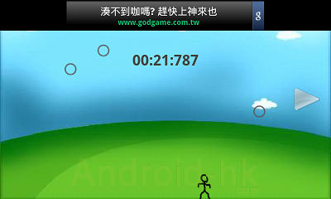
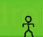
Planning Features
Basic
People *In one Cell
Balls phone screen
Angle sensor
Advance
Two players support*
Bluetooth connection
Acceleration

Slide 6
That’s Take a Look at…
Falling Ball v.Duo on
HERO & DESIRE

