Slide 1
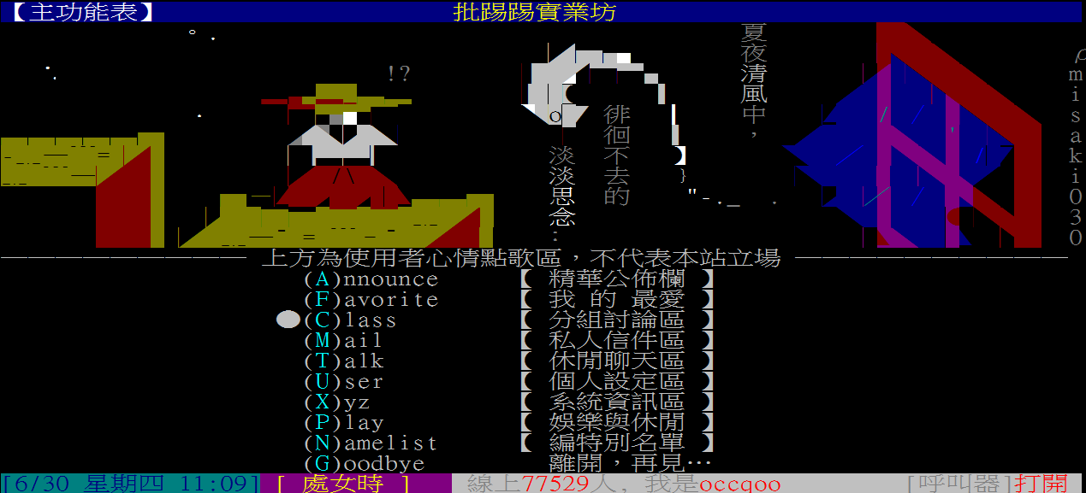
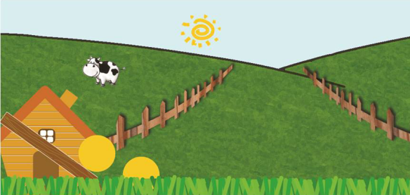
Rolling the Cheese 2.0
Ptt Agent
歐順興
施博仁
魏振宇

Slide 2
Let’s talk about the story!

Slide 3
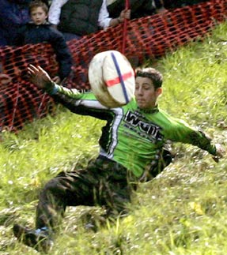
Cooper's Hill Cheese-Rolling in England

Slide 4
Well, it’s funny.
However……

Slide 5


Slide 6
It’s as hard as taking the NMLab course.

Slide 7
Now, all you need is a an Android smart phone

Slide 8


Slide 9
We are more peaceful

Slide 10
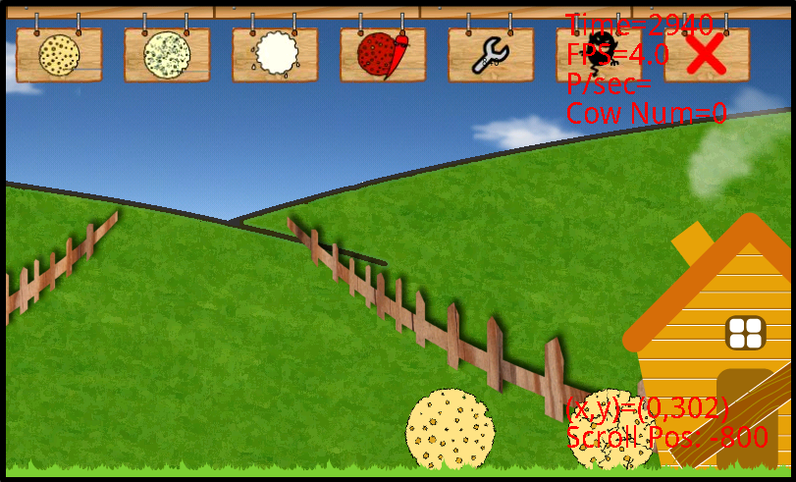
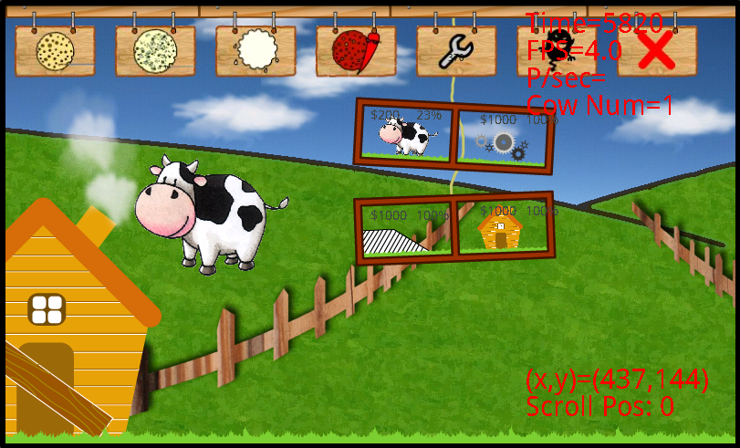

Slide 11
With the new network core,
we improves at least 70% performance.

Slide 12
For the two-player mode, we don’t need a PC server anymore. The server side actually act as a portable hotspot.

Slide 13
We send “object” after compression.

Slide 14
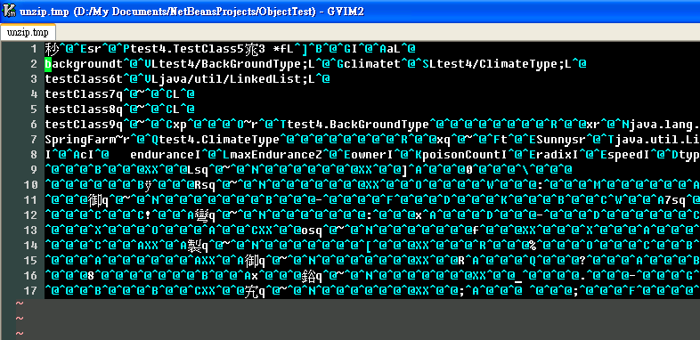
Object transmission actually has too much repetitive data

Slide 15
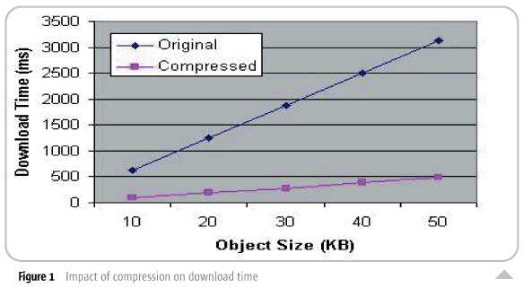
Underlying Deflate Algorithms
Reduce the average object size by 80%
From http://www2.sys-con.com/itsg/virtualcd/java/archives/0810/beckett/index.html

Slide 16
New graphic tech reduce 30% memory usage.

Slide 17
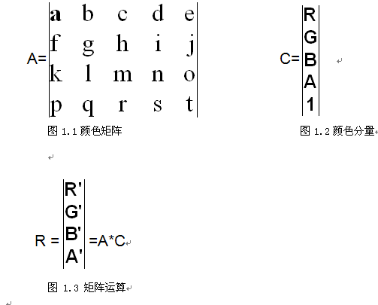
ColorMatrixColorFilter

Slide 18
Other graphic Tech
LightingColorFilter
  (R’, G’, B’) = (R, G, B)‧(a, b, c) + (d, e, f)
Draw bitmap after a matrix
A transparent rectangle mask background

Slide 19
Other Improvements
More careful resources management
  onResume(), onPause(), onDestroy()
  Thread management => 9 threads at a time
We debugged a lot
Landscapes change with time

Slide 20
Other Improvements
We compose our cheese theme song!

Slide 21
Demo

Slide 22
Ok, it’s great!

Slide 23
However, I have no time to use Ptt after I start to roll the cheeses.

Slide 24
It’s good to prove that I am not an “otaku“, but ...

Slide 25
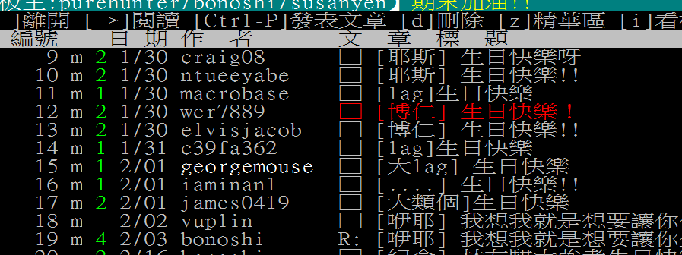

Slide 26

You need “Ptt Agent”!
PTT

Slide 27
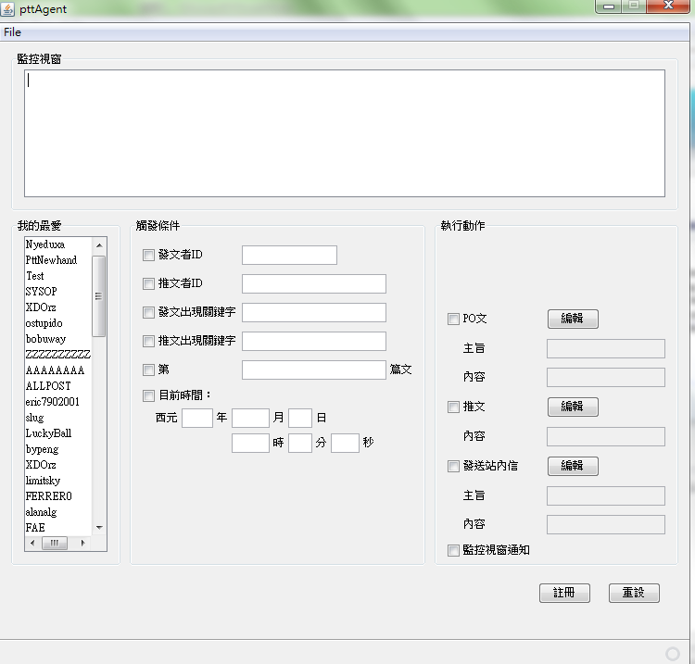

Slide 28
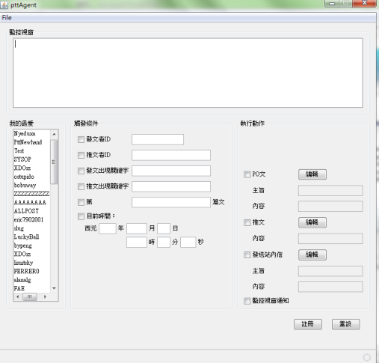


Slide 29
With Ptt Agent, you can …

Slide 30
Post or Push an article automatically.

Slide 31
Follow someone’s “posts” and “pushes”.

Slide 32
Get informed when some specific keyword appear.

Slide 33
Get Ptt’s money as soon as posible.

Slide 34
And ……

Slide 35
Demo

