Slide 1

PROXY X
Network and Multimedia Lab
Group 2
陳柏亘、郭祖豪、吳張祺

Slide 2

Introduction
Intro to Kinect and RS Media
Motivation
How We Implement
Demo
Future Development

Slide 3
Introduction
Kinect as an input interface to control robot by directly moving our body.
Lots of similar concept have been shown in sci-fi movie.

Slide 4
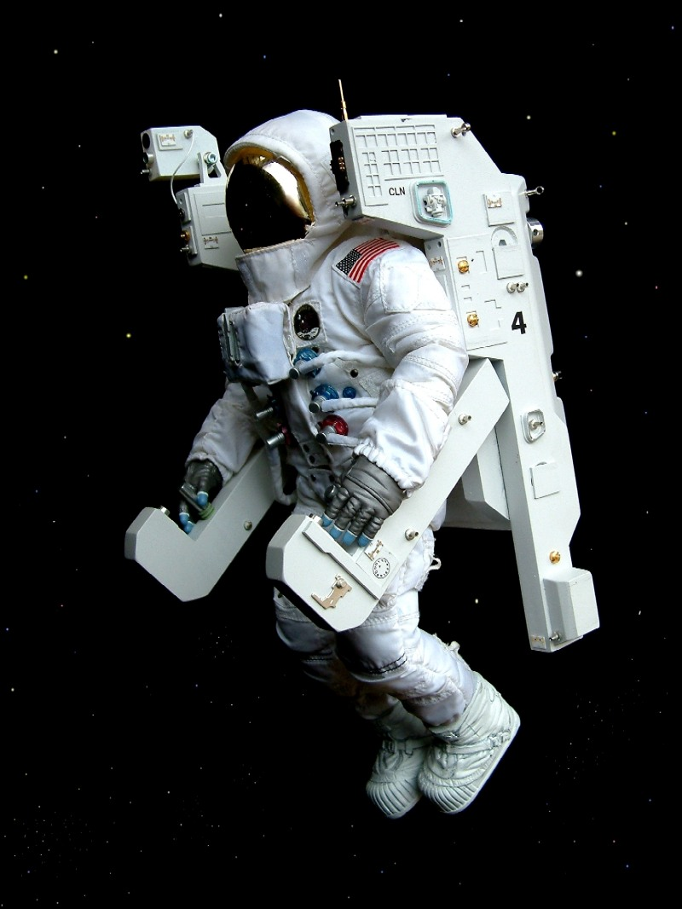
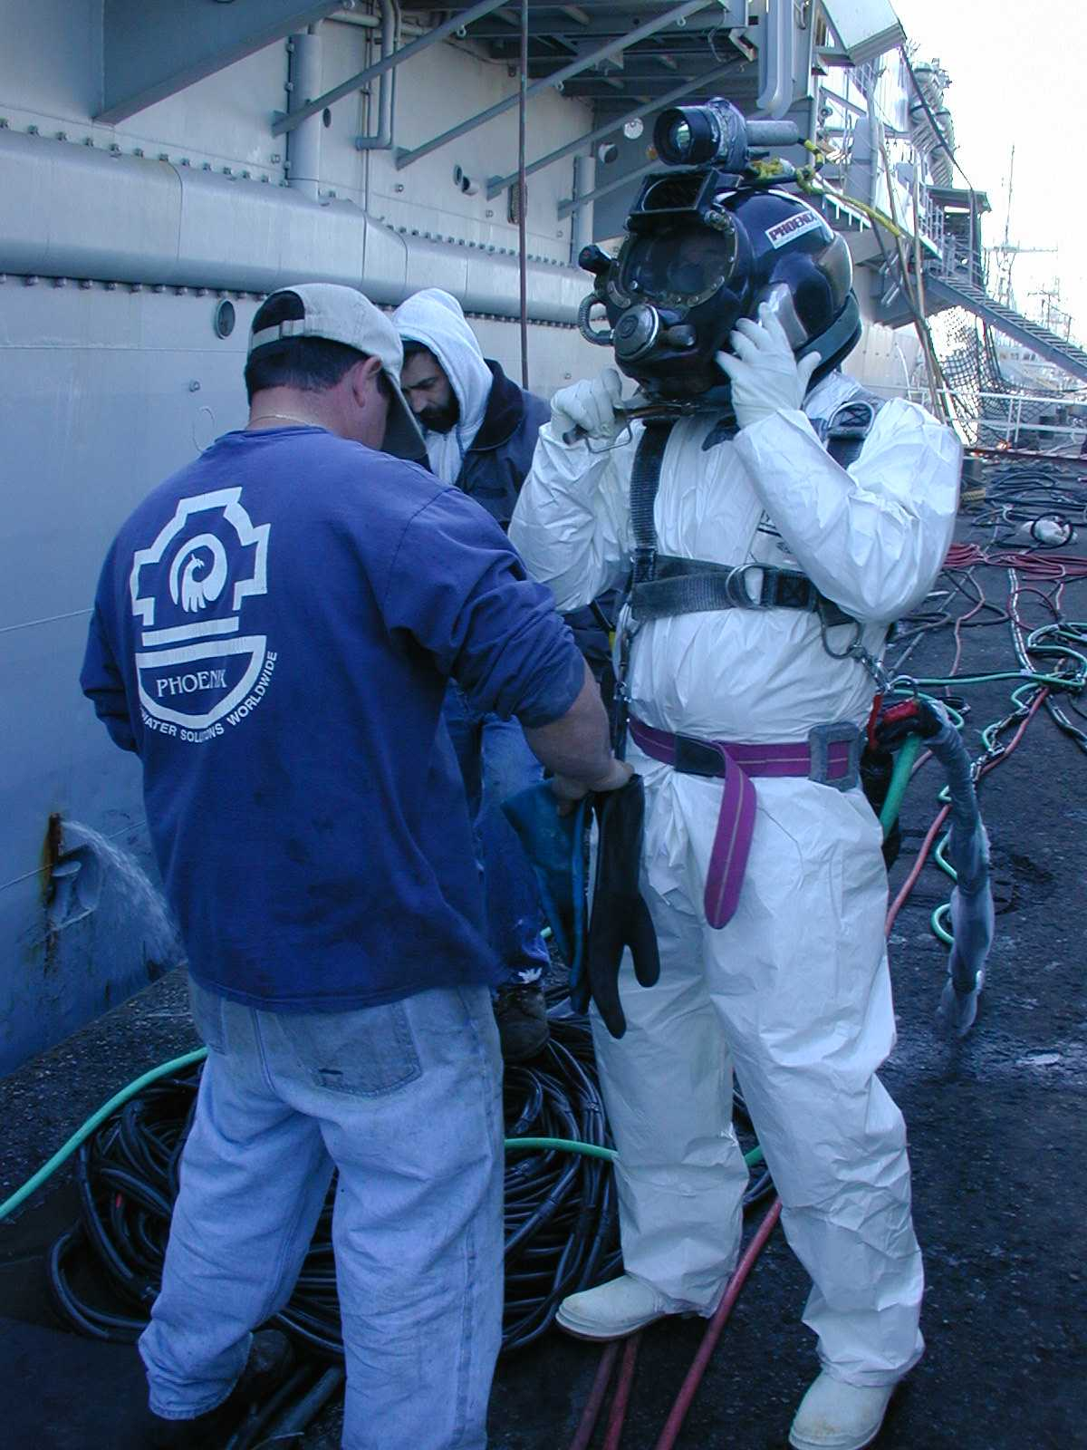
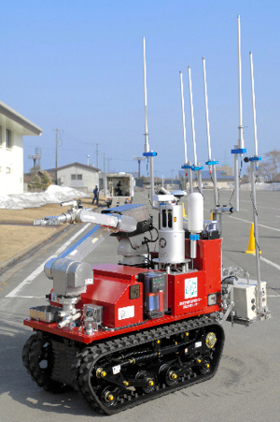

Motivation
Lots of work can be done in a safer way
  Dangerous Task
  Extreme Environment
Work will be easier and safer in this way
Robotic body with human judgment

Slide 5
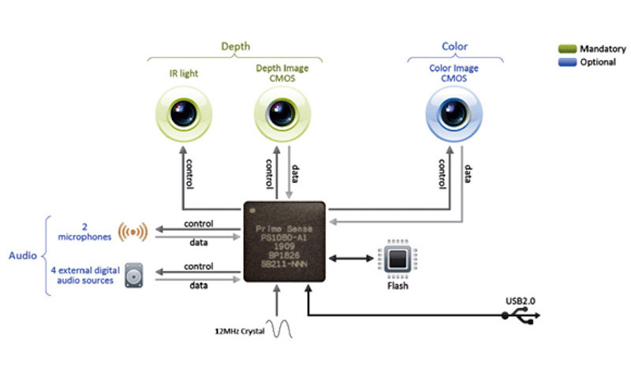
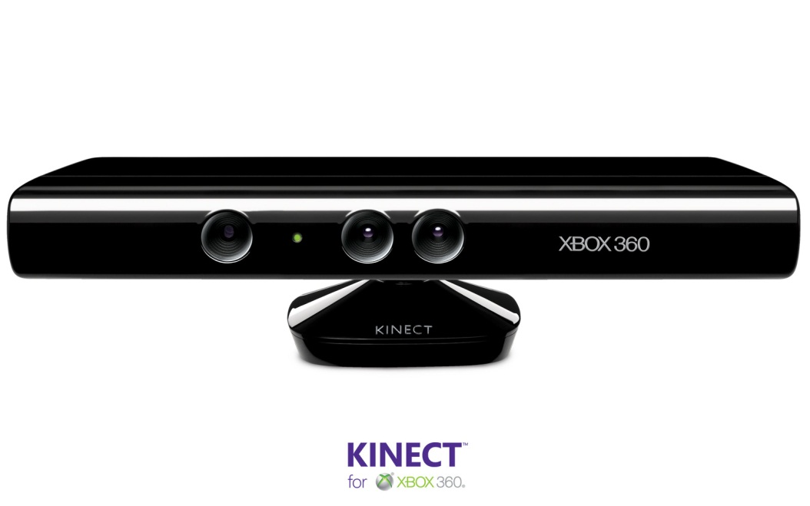
Kinect
What is Kinect?
Kinect is a motion sensing input device by Microsoft for the Xbox 360 video game console.
Source: PrimeSense

Slide 6
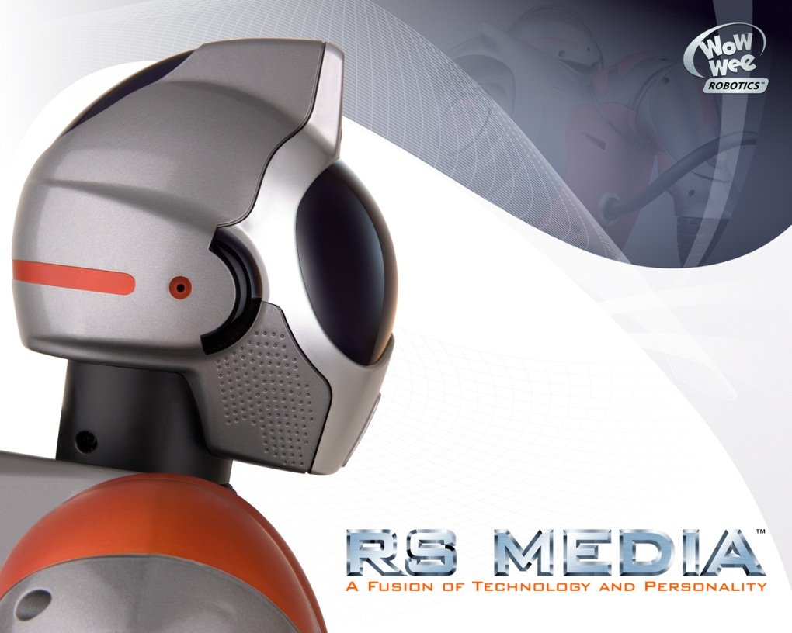
RS Media
A biomorphic robot from WowWee
With multiple sensors
With Linux Kernel!!!
Spec:
Two primary processors:
  200MHz ARM9 with 64MB of flash RAM for the primary LINUX
  operating system and user files
  Custom 16 bit processor for handling the biomorphic robot functions
16MB (2006 Model) or 32MB (2007 Model) of RAM
1 USB port
Stereo audio plug
SD card slot (accepts up to 1GB cards)
VGA color camera in the forehead for image recognition, and video recording
20kHz microphone in the chest for audio recording
1.9" 176x132 pixel color TFT supertwist LCD screen in its chest
11W 3-speaker system (2 x metal speakers + 1 back-mounted woofer)
Power-adapter port in foot
12 motors based on the configuration found in the Robosapien V2
Sensor:
3 infrared (IR) detectors that use IR ranging for object detection
VGA quality camera in its forehead for video and human-tracking abilities
3 sound sensors for sound localization and audio recording
2 touch sensors on the back of each hand
1 toe and 1 heel touch sensor in each foot
Source: WowWee

Slide 7
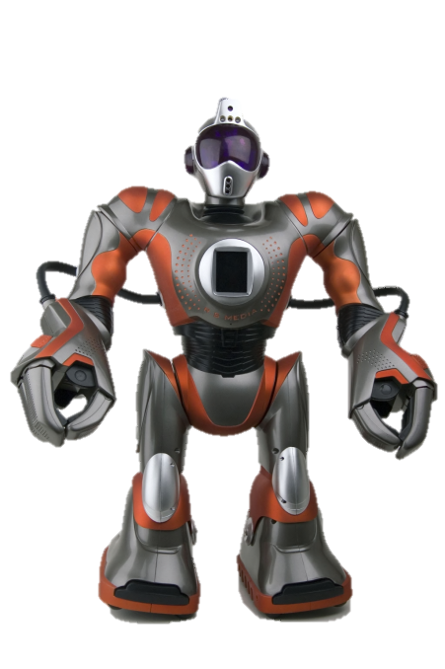
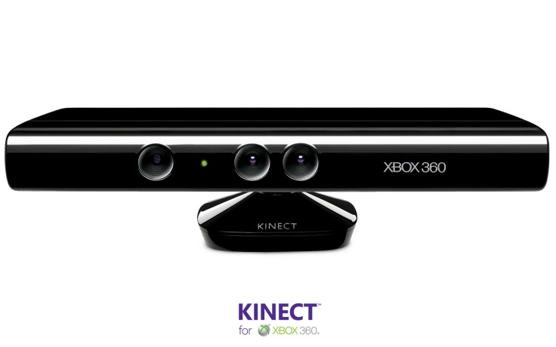
System Structure
1
2
RS Media
Linux Console
User Tracker

Slide 8
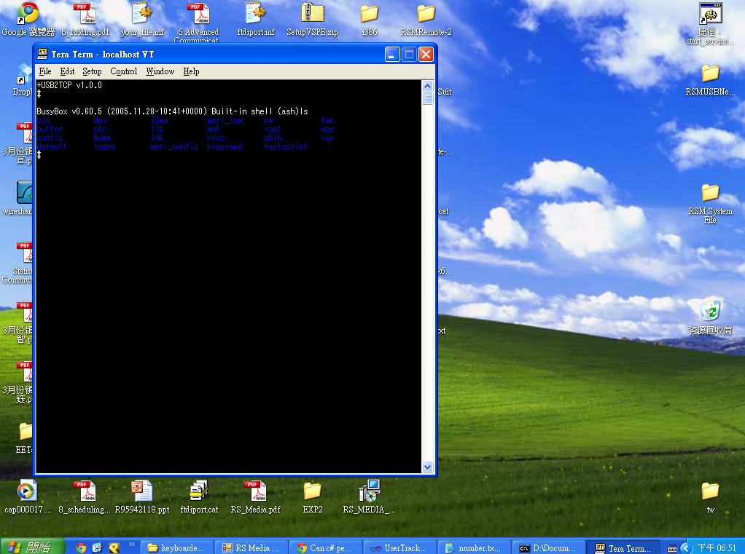
Control of RS Media
We want to use Infrared at first
RS Media has an built in Linux kernel
If able to reach the kernel, lots of things can be done
To reach the kernel
  We use as inter connector
  Configure USB as COM port
  Establish TCP connection over USB
  Change the driver in RS Media
  Change the driver in PC
  Use terminal emulator to connect RS Media

Slide 9
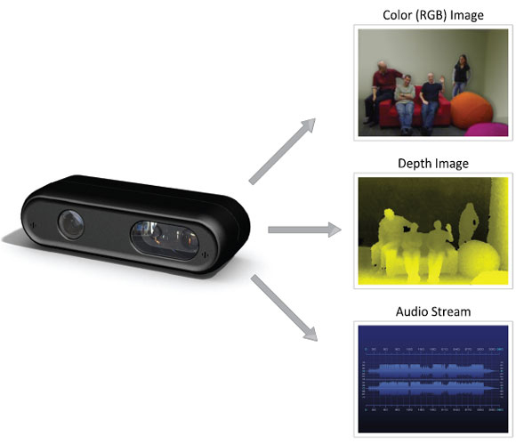

Kinect – User Tracker

Slide 10
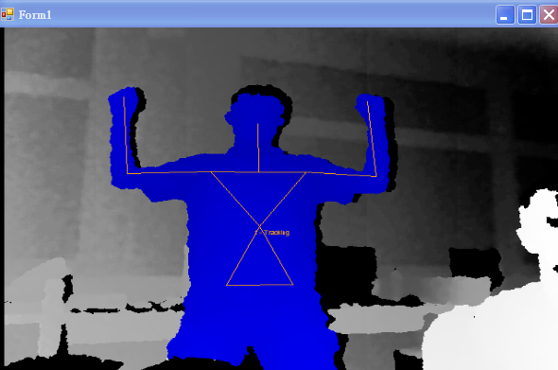
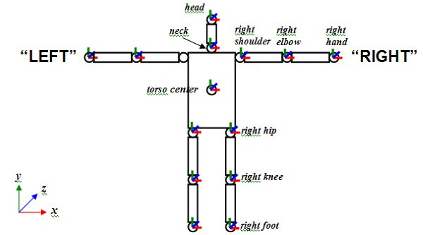
Kinect – User Tracker
Microsoft didn’t release official SDK until last week
Open Source Library : Open NI + PrimeSense Nite
User Skeleton Tracking
Source: http://kheresy.wordpress.com/2011/01/28/detecte_skeleton_via_openni_part1/

Slide 11


Slide 12

Future Development
Different aspect of NMLab
More functionality of RS Media

Slide 13



Slide 14
Thank You!

Slide 15
Back Up

Slide 16
WowWee RS Media
Spec:
Two primary processors:
  200MHz ARM9 with 64MB of flash RAM for the primary LINUX operating system and user files
  Custom 16 bit processor for handling the biomorphic robot functions
16MB (2006 Model) or 32MB (2007 Model) of RAM
1 USB port
Stereo audio plug
SD card slot (accepts up to 1GB cards)
VGA color camera in the forehead for image recognition, and video recording
20kHz microphone in the chest for audio recording
1.9" 176x132 pixel color TFT supertwist LCD screen in its chest
11W 3-speaker system (2 x metal speakers + 1 back-mounted woofer)
Power-adapter port in foot
12 motors based on the configuration found in the Robosapien V2
Sensor:
3 infrared (IR) detectors that use IR ranging for object detection
VGA quality camera in its forehead for video and human-tracking abilities
3 sound sensors for sound localization and audio recording
2 touch sensors on the back of each hand
1 toe and 1 heel touch sensor in each foot
A Linux kernel as its brain.

Slide 17
What have we done?
RS Media is an linux kernel based toy robot. We have to change the driver of both robot and PC to reach the linux console within the robot.
Kinect’s human motion detection.
Connection between the motion detection part with the control of robot.

Slide 19
System Structure
RS Media
Linux Console
User Tracker

Slide 20
Back Up

Slide 21
What is our final project and it’s purpose
We try to use kinect as an input interface to control robot by directly moving our body.
Lots of similar concept have been shown in sci-fi movie.
Lots of work whish is too dangerous can be done in this way. (ex, Fukushima nuclear danger, defuse bomb, extreme environment)
Kinect makes this much more easier.

Slide 22
Inter Program Communication
Methods:
Inter-process Communication
Windows SDK – Message Queue
C sharp: Find Window + Keyboard Event

